Slide 1
Open source Integration
Souciance Eqdam Rashti
souciance.eqdam.rashti@gmail.com
https://github.com/SoucianceEqdamRashti/Integration

Slide 2
Souciance Eqdam Rashti
•
Integration at Axiell Public Library in R&D
Developing microservices for Axiell Quria
”A cloud based library management platform”
•

Slide 3
Agenda
Why open source?
Open source platform
Apache Camel
Apache Karaf
Maven
Test
Unit & integration tests
Build & Deploy
Microservices with docker
Q&A
Demo

Slide 4
Why Open Source ?
Use existing standards within software development
Test, build & deploy, container, programming language and ecosystem
No expensive licensing fees
Can scale without first thinking of budget
Commerical versions available
Modular components
Use what you need, don’t get a huge package with everything
Simpler for existing programmers to get started
Easy to fit with a microservice approach
Fits well with docker
Used by large and small organisations
Skip if you have a pure SAP, Oracle or Microsoft environment
If you absolutely must use graphical tools
Graphical mapper is being developed

Slide 5
Open Source Products
Apache Camel is the most popular framework for developing integrations
Equivalent of a broker flow but not dependent on a runtime environment
But we still need a runtime environment..
Apache Karaf is a simple, and powerful container to deploy run and administrate Camel artefacts
It is the equivalent of the broker runtime
Easy to get started
ServiceMix..too old
Spring boot – will require spring compentence
Commercial options
Red Hat Jboss Fuse
Talend

Slide 6
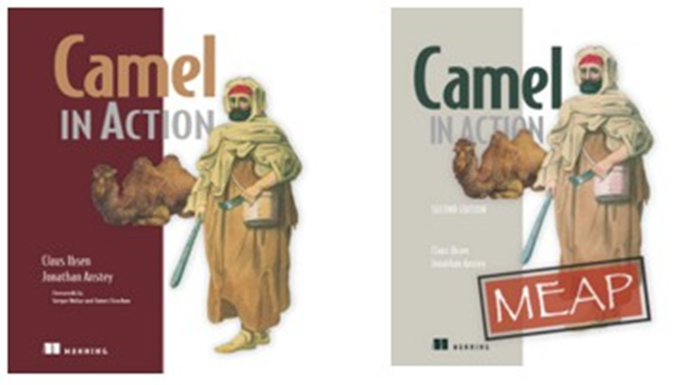

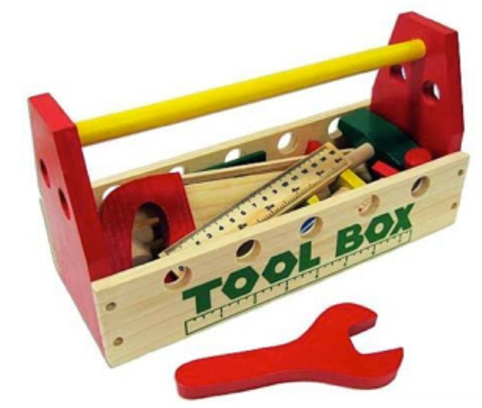
Apache Camel
Apache Camel is a powerful Open Source Integration Framework based on
Enterprise Integration Patterns

Slide 7
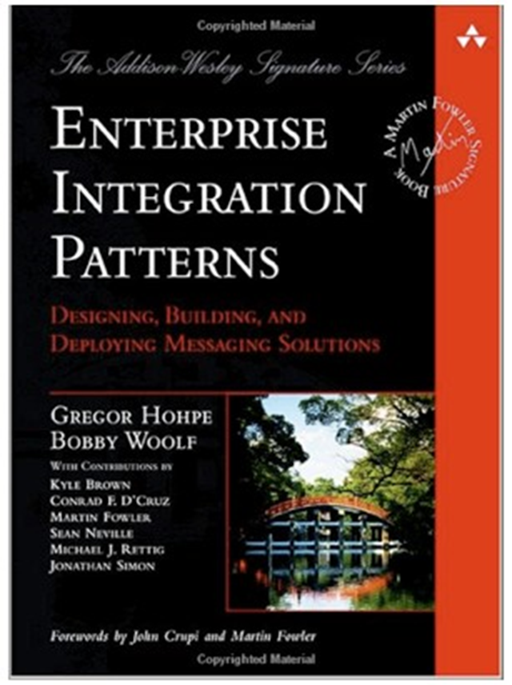
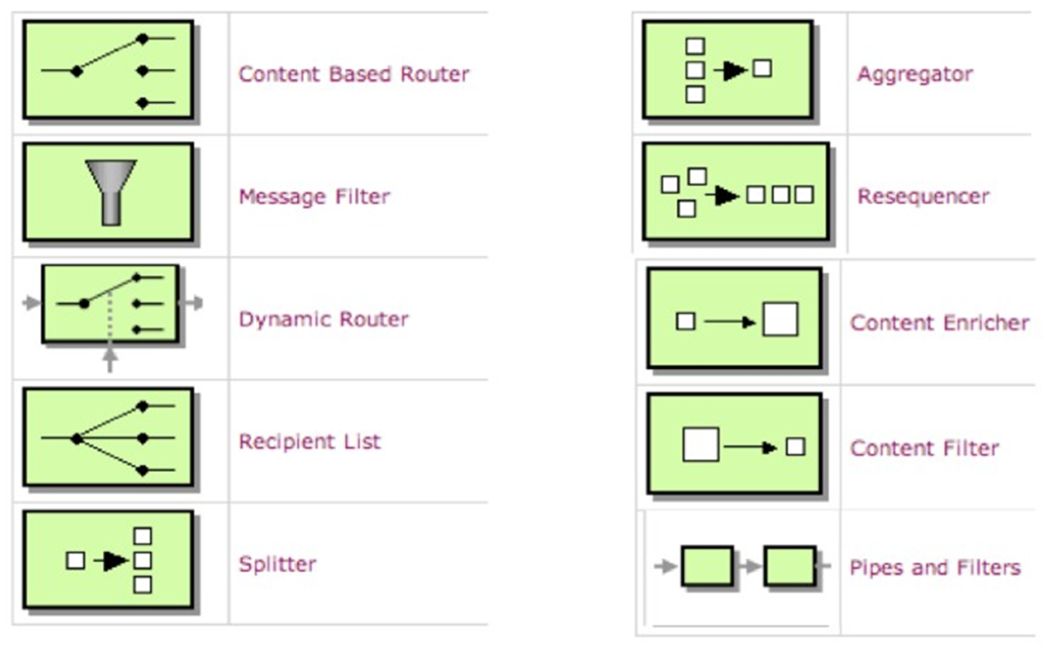
Foundation - Patterns

Slide 8
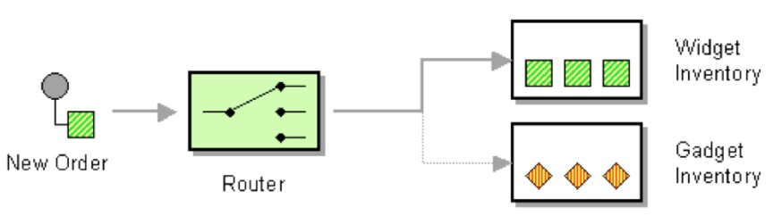
Content Based Router

Slide 9
Content Based Router
from newOrder

Slide 10
Content Based Router
from newOrder choice

Slide 11
Content Based Router
from newOrder choice
when isWidget to widget

Slide 12
Content Based Router
from newOrder choice
when isWidget to widget otherwise to gadget

Slide 13
Content Based Router
from(newOrder) choice
when(isWidget) to(widget) otherwise to(gadget)

Slide 14
Content Based Router
from(newOrder)
.choice()
.when(isWidget).to(widget)
.otherwise().to(gadget);

Slide 15
Content Based Router
Endpoint newOrder = endpoint("activemq:queue:newOrder");
from(newOrder)
.choice()
.when(isWidget).to(widget)
.otherwise().to(gadget);

Slide 16
Content Based Router
Endpoint newOrder = endpoint("activemq:queue:newOrder"); Predicate isWidget = xpath("/order/product = 'widget'");
from(newOrder)
.choice()
.when(isWidget).to(widget)
.otherwise().to(gadget);

Slide 17
Content Based Router
Endpoint newOrder = endpoint("activemq:queue:newOrder");
Predicate isWidget = xpath("/order/product = 'widget'");
Endpoint widget = endpoint("activemq:queue:widget");
Endpoint gadget = endpoint("activemq:queue:gadget");
from(newOrder)
.choice()
.when(isWidget).to(widget)
.otherwise().to(gadget);

Slide 18
Java Code
public void configure() throws Exception {
Endpoint newOrder = endpoint("activemq:queue:newOrder"); Predicate isWidget = xpath("/order/product = 'widget'"); Endpoint widget = endpoint("activemq:queue:widget"); Endpoint gadget = endpoint("activemq:queue:gadget");
from(newOrder)
.choice()
.when(isWidget).to(widget)
.otherwise().to(gadget);
}

Slide 19
Java Code
import org.apache.camel.Endpoint; import org.apache.camel.Predicate;
import org.apache.camel.builder.RouteBuilder;
public class MyRoute extends RouteBuilder { public void configure() throws Exception {
Endpoint newOrder = endpoint("activemq:queue:newOrder"); Predicate isWidget = xpath("/order/product = 'widget'"); Endpoint widget = endpoint("activemq:queue:widget"); Endpoint gadget = endpoint("activemq:queue:gadget");
from(newOrder)
.choice()
.when(isWidget).to(widget)
.otherwise().to(gadget);
}
}

Slide 20
Java DSL
import org.apache.camel.builder.RouteBuilder;
public class MyRoute extends RouteBuilder {
public void configure() throws Exception { from("activemq:queue:newOrder")
.choice()
.when(xpath("/order/product = 'widget'"))
.to("activemq:queue:widget")
.otherwise()
.to("activemq:queue:gadget");
}
}

Slide 21
XML DSL
<route>
<from uri="activemq:queue:newOrder"/>
<choice>
<when>
<xpath>/order/product = 'widget'</xpath>
<to uri="activemq:queue:widget"/>
</when>
<otherwise>
<to uri="activemq:queue:gadget"/>
</otherwise>
</choice>
</route>

Slide 22


Endpoint URIs
<route>
<from uri="file:inbox/orders?delete=true"/>
<choice>
<when>
<xpath>/order/product = 'widget'</xpath>
<to uri="activemq:queue:widget"/>
</when>
<otherwise>
<to uri="activemq:queue:gadget"/>
</otherwise>
</choice>
</route>
Parameters

Slide 23
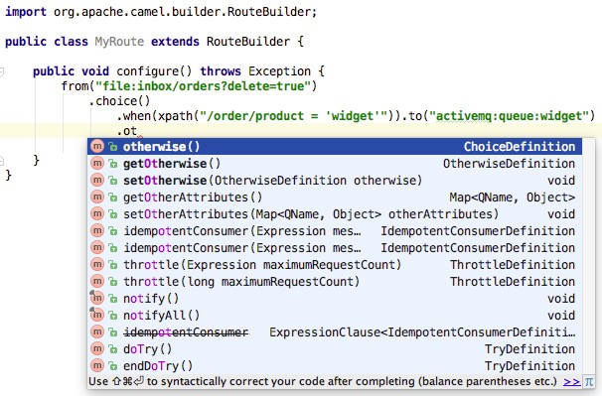
Just Java Code

Slide 24
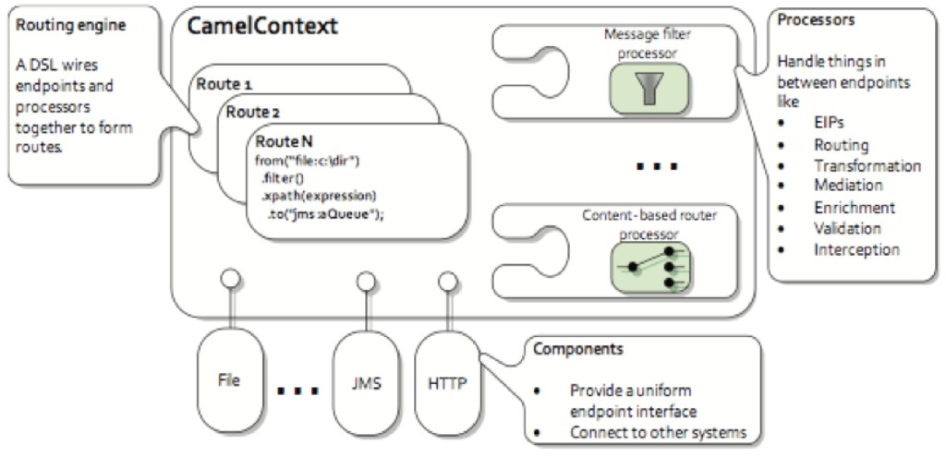
Architecture

Slide 25
Camel architecture
CamelContext – The Camel instance running in the JVM
Camel route – A single individual flow
Camel endpoint – Some uri defining where to get information from and where to send it
Came processors – Inline or separate to help with additional functionality
Camel components – extra functionality as a plugin
CamelContext → Route(s) → Endpoint(s), Processor(s), Component(s)

Slide 26
Components: 200+
ahc | bindy | coap | docker
ahc-ws | blueprint | cometd | dozer
apns | boon | context | dropbox
atmosphere | box | couchdb | eclipse
atom | cache | crypto | ejb
aws | cassandraql | csv | elasticsearch
bam | castor | cfx | elsql
bean-validator | cdi | cxf-transport | eventadmin
beanio | chunk | disruptor | exec
beanstalk | cmis | dns | facebook

Slide 27
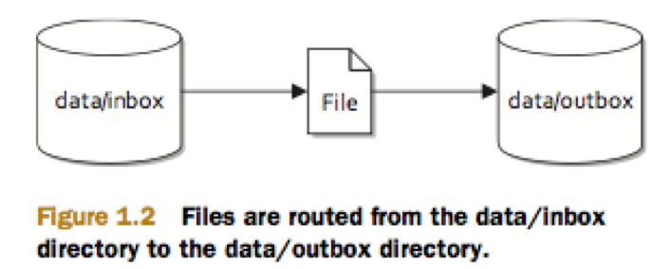
An example
File Copier Example

Slide 28
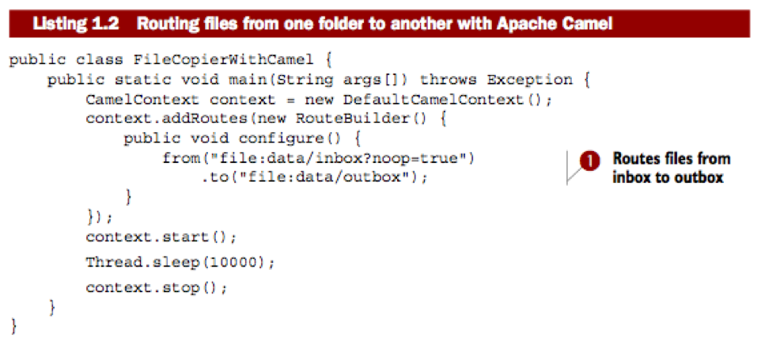
Camel code for example

Slide 29
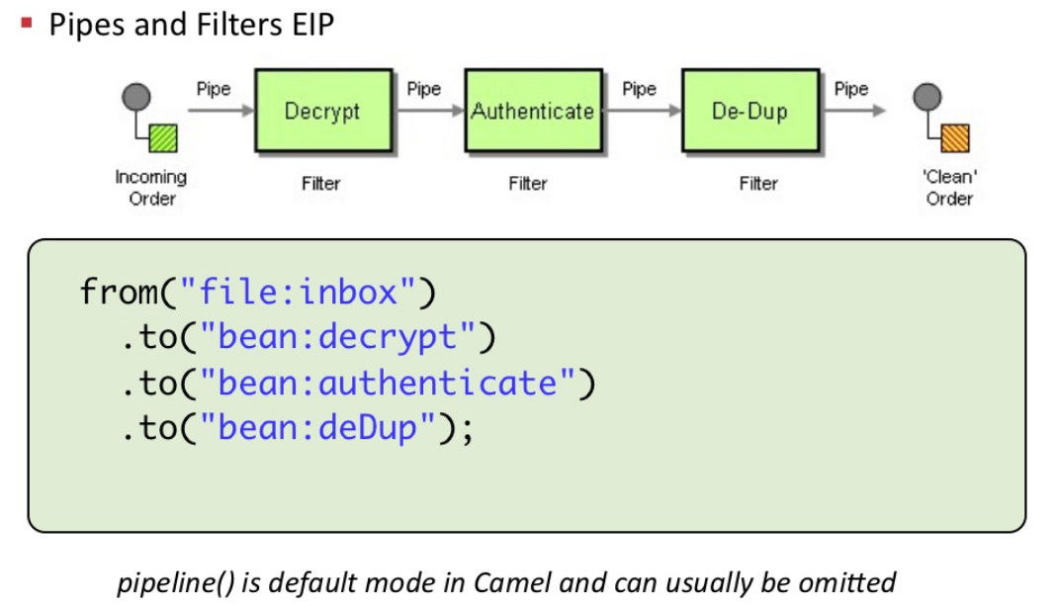
We don’t have palette with nodes..

Slide 30
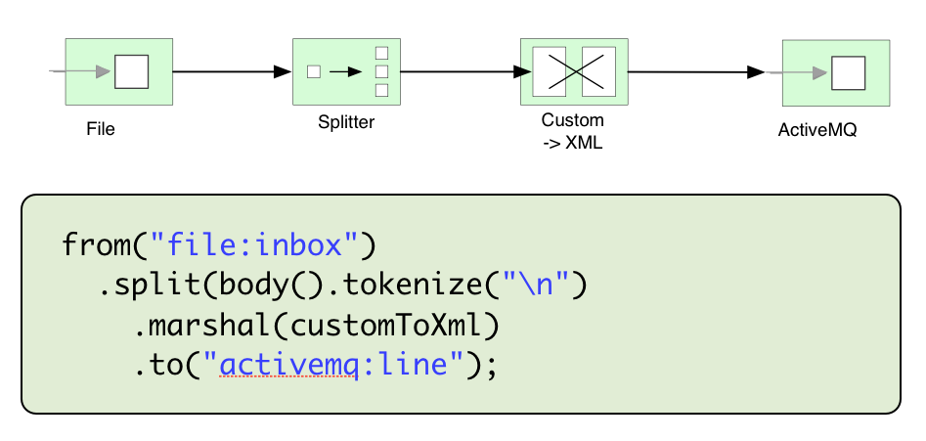
Splitter

Slide 31
More examples

Slide 32
Test
Powerful test framework
You can perform unit tests
Test individual processors
Test routes
Mock and intercept
Use expectation
Inject messages
You can perform integration tests
Send message to RabbitMQ

Slide 33
Test examples

Slide 34
Advanced Camel
Camel metrics
Jolokia monitoring
Using Consumer and Producer templates
Retry and complex error handling
Generic routes (reusable flows)
Build your own plugins
...much more

Slide 35
Apache Karaf
THE runtime environment..
Think of it as a repository where you deploy artefacts
Deploy manually, maven, or http
Manual deployment ok for developer machine
Maven for production
Good Camel integration
With Hawtio installed you have a powerful runtime environment that can match expensive commercial platforms

Slide 36
Karaf demo

Slide 37
Custom distribution of Karaf
What we want:
Build a custom and portal distribution of your runtime and Camel artefacts into a compressed file
The distribution can be shared or used for deployment in your build&deploy
You can easily customize things like branding, logging and other properties
First step to combine with docker
Demo

Slide 38
Custom distribution with Docker
Docker is an isolated lightweight OS where your applications run
Docker is good for:
Same app across all environments
Scaling and moving from one environment to another
Easy for devops if you have the right monitoring tool
If the docker container dies it has no affect
Restart the container
Spin a new one
All persistent data stored elsewhere
We combine the power of Camel, Karaf with Docker

Slide 39
Build&Deploy flow
Developer code and tests integration
Developer builds the feature files
Developer builds the custom distribution
Developer creates the Dockerfile describing how to unpack and start the custom distribution
Developer creates a PR
Code is merged
Jenkins job is triggered
The Camel project tests are run, built and sent to Artifactory
Jenkins builds the docker image from the dockerfile and publishes it to dockerhub
We deploy to our environment via Ansible

Slide 40
Our goal..
Move away from centralised platforms which have a single point of failure
Each integration is deployed with its own configuration and runtime
An integration crash will not affect another integration
If the container dies we become aware and spin a new one
Ideal world – environment is ”self-aware”

Slide 41
Build&Deploy example

Slide 42
Lessons learned
Know your VERSIONING
Biggest headache is to know which versions work with which
Use custom distributions to test
Know your eco-system
A LOT of products out there that can be used
Know your best practises
Different best practises exist
Test and use one which works the best
Be prepared to read a lot of code to learn
Stay update with latest features

Slide 43
Product positioning
OS | License
Apache Camel | IIB (Eclipse)
Apache Karaf | IIB runtime
Hawtio | IIB web console
APIMan | Datapower
Smooks | WTX
RabbitMQ, ActiveMQ | WMQ

Slide 44
Summary
Open source platforms can be a good alternative
Be prepared to do experiment, investigate and test
You will write more tests than ever before
Use more tools than a single solution for all
Free to use your IDE of choice
No software licencing fees
Deploy to a physical server, VM or docker
Scale your host or scale your containers
More programming required
Message models exist for simpler kinds
More advanced messages will need their own parsers
Documentation helps but not as good as the IBM Infocenter
Above all:
A small runtime footprint
Your integrations run in isolation → If one crashes it has no afffect on all the others (exception group, broker)
All the main administration commands available
Metrics regarding number of messages and performance

Slide 45
QA

